Slide 1



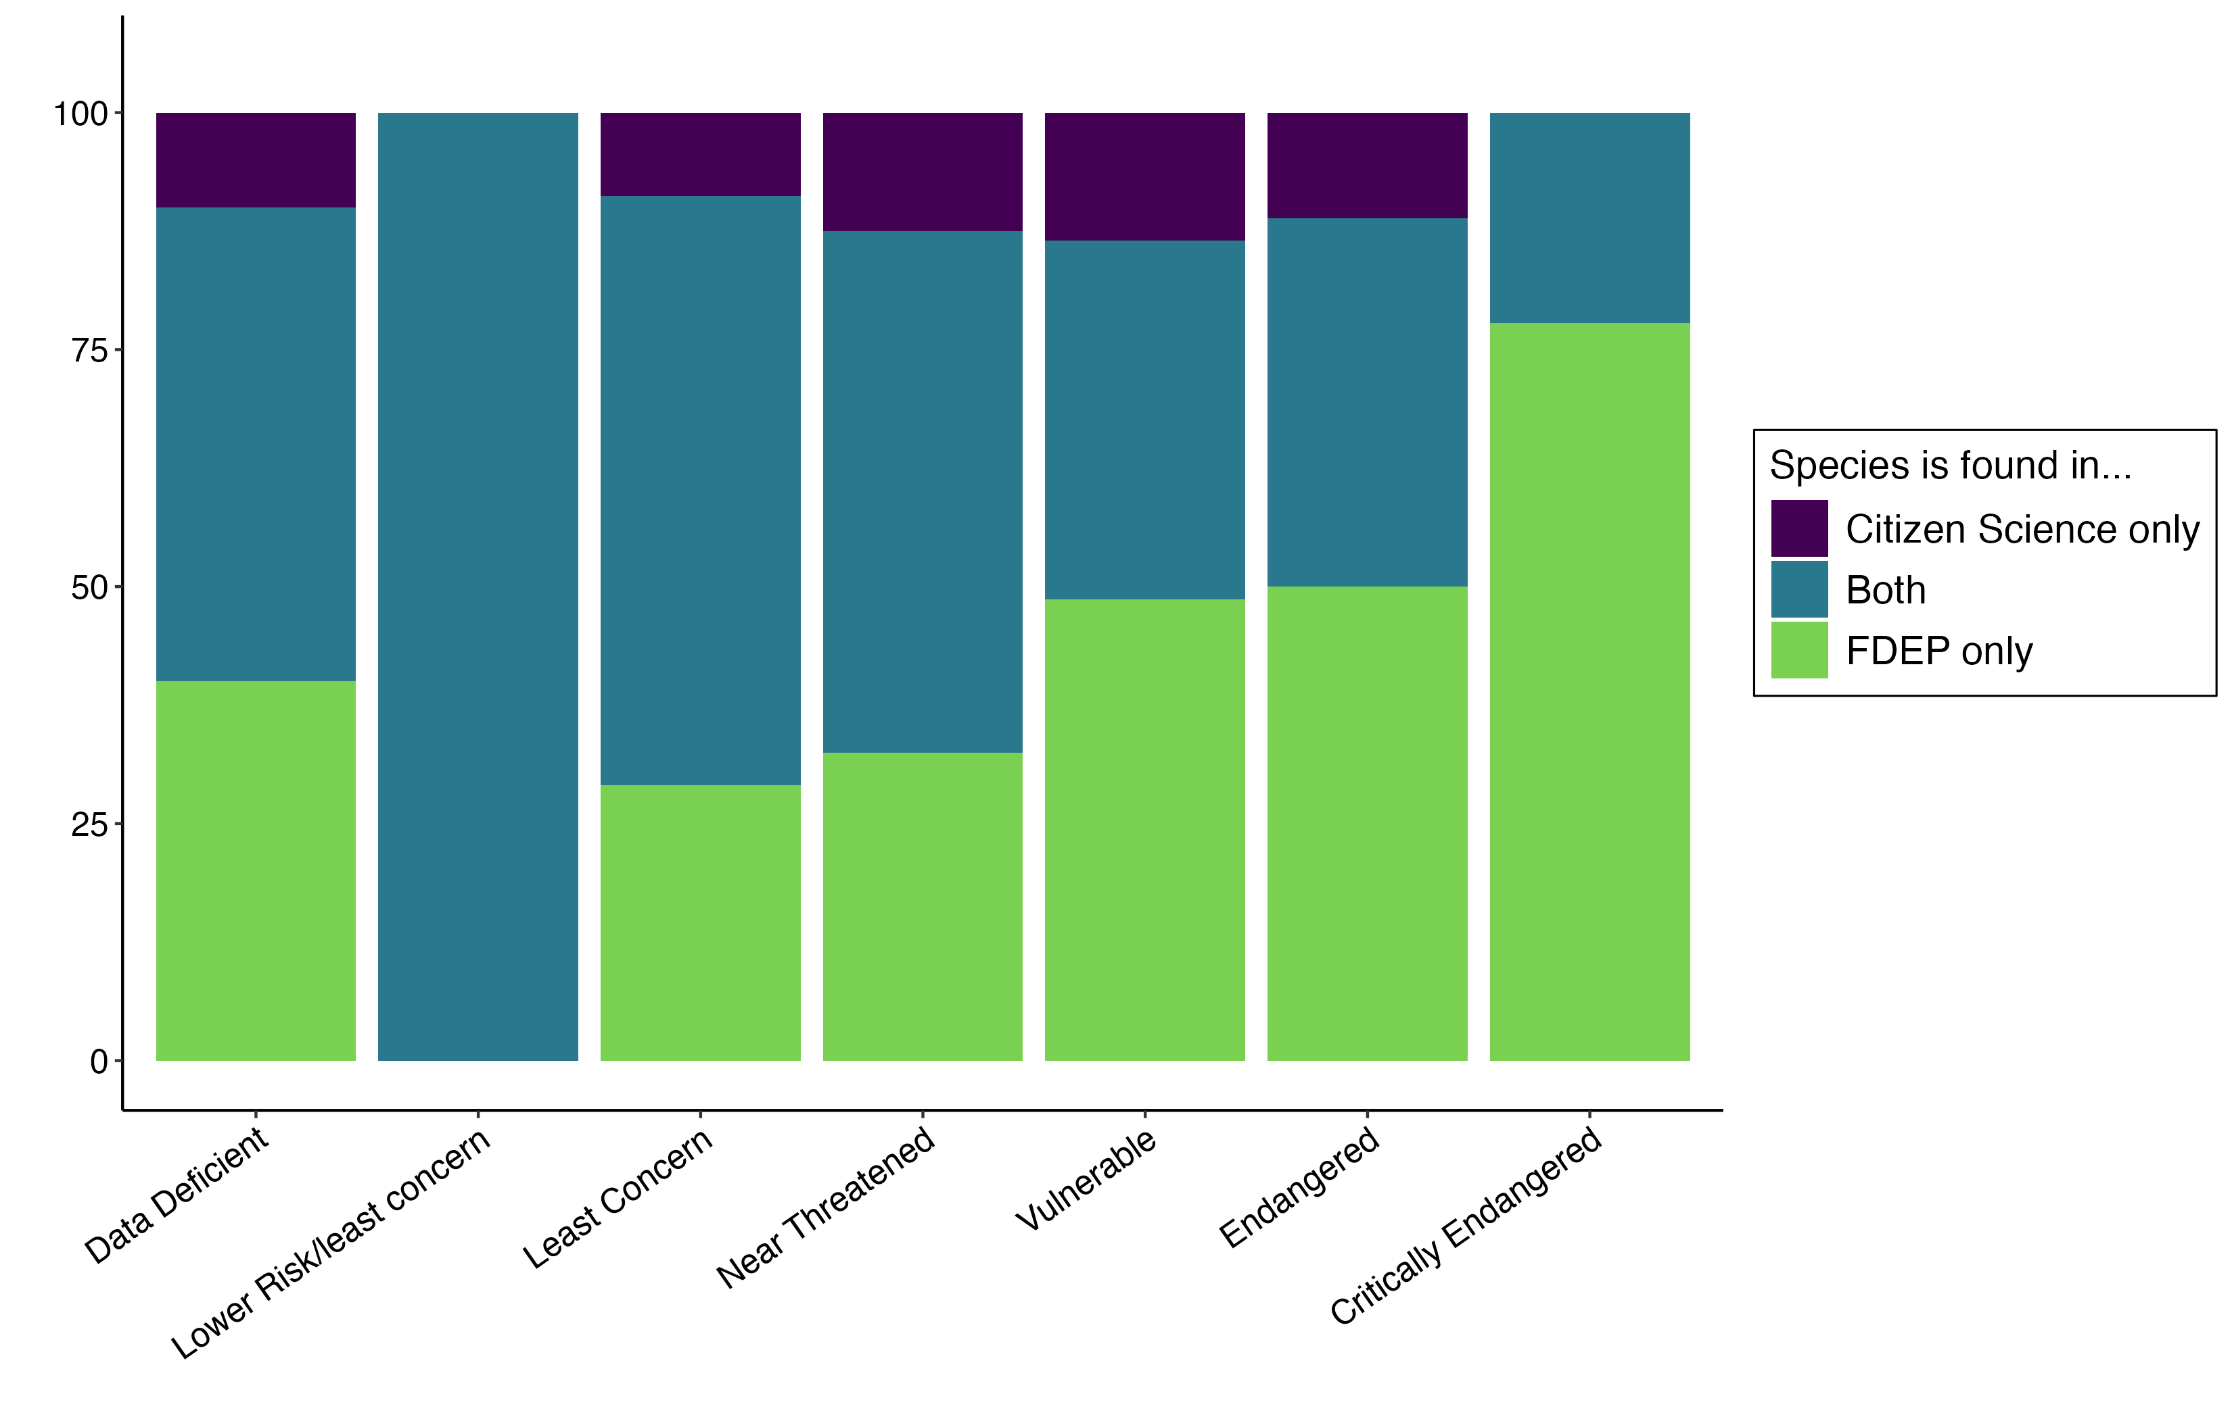
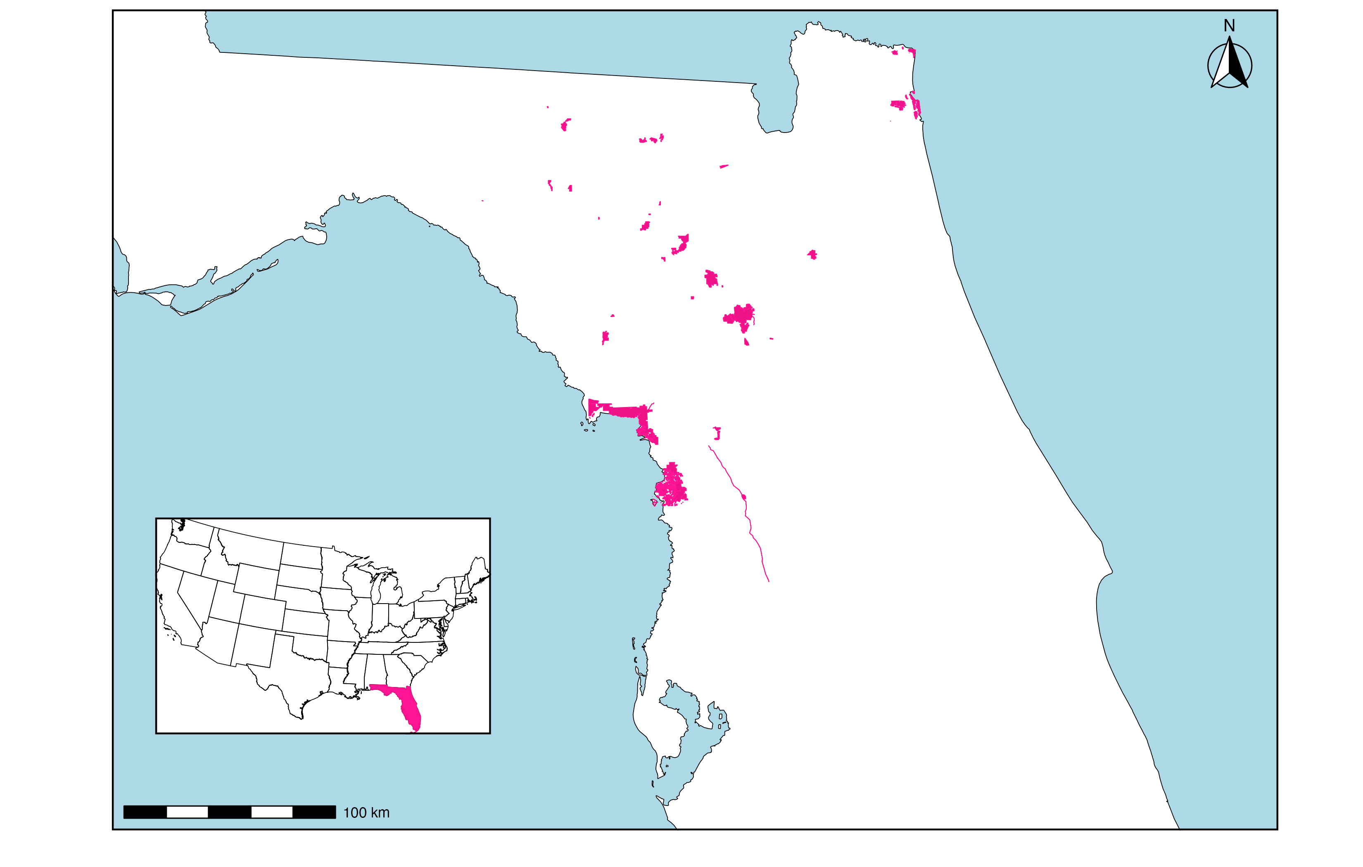




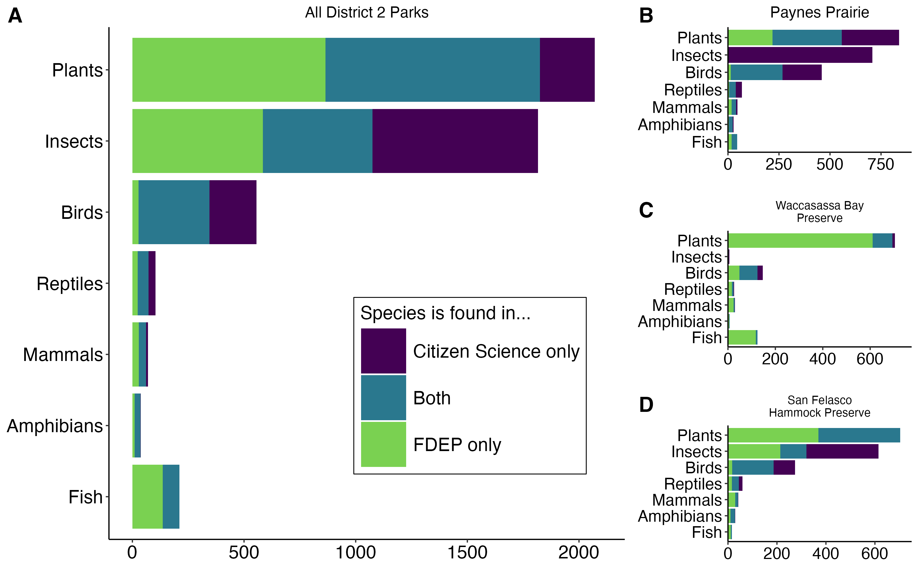
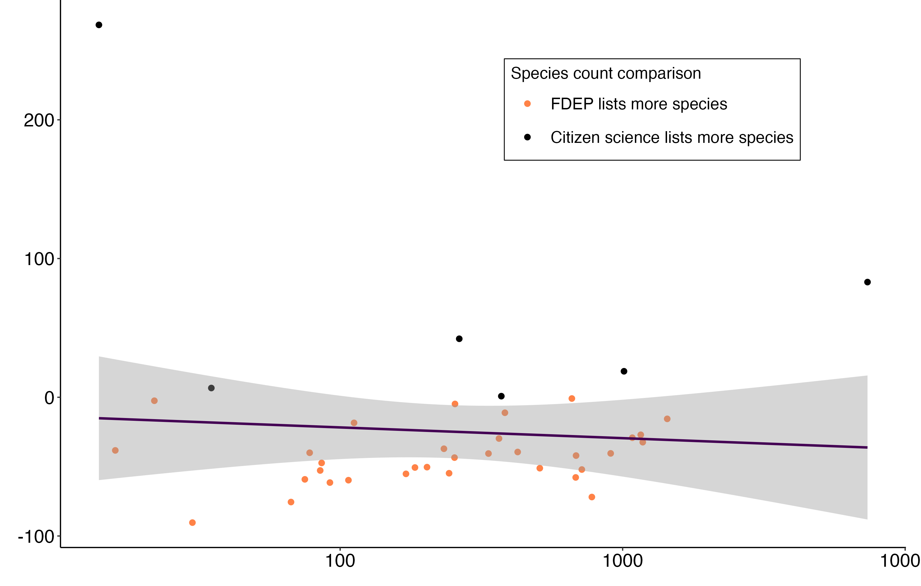
Citizen science data complements state agency data to fill gaps in species inventories of state parks
Samantha Lowe¹, Brittany M. Mason², and Corey T. Callaghan^{1,2}
¹School of Natural Resources and Environment, University of Florida
²Department of Wildlife Ecology and Conservation, University of Florida
Introduction
The Florida Department of Environmental Protection (FDEP) is a state agency that oversees 175 state parks and trails across 6 regulatory districts in the state of Florida.
To best manage lands, FDEP creates Management Plans for parks that are updated every 10 years.
Each district has a presence-only species list for parks based on cumulative findings of agency-conducted species inventories.
We examined how species lists created by FDEP for 39 parks compare to the lists of species in each park generated by citizen science observations from iNaturalist and eBird.
Research Questions
Can citizen science data be used in conjunction with state agency data to create more complete species inventories in state parks?
Are there any types of species/taxa that citizen science and/or state agency data favor?
What park qualities lead to differences in the contents of citizen science species inventories and state agency species inventories?
n = 10 n = 1 n = 1204 n = 40 n = 37 n = 18 n = 9
Percent of species
IUCN Conservation Status
Figure 3. Across all 39 parks, 1,319 species have IUCN-reported conservation statuses, as shown in plot colored by data source. Notably, more than 4,000 species in parks have no IUCN status.
Results
Discussion
Citizen science data could improve the completeness of species lists in management plans without increasing the burden on state agencies.
Citizen science data appears to consistently provide otherwise undocumented insect species.
We hope to learn more by expanding this research to include other parks and other state-managed lands with species inventories.
5,560 species across all 39 parks
3,948 species recorded by FDEP
&
3,646 species recorded by the citizen scientists
Figure 1. Map of 39 parks in Florida managed by FDEP in the Northeast regulatory district (District 2).
Methods
Obtained FDEP District 2 species list with inventories of 39 parks.
Created ‘Citizen Science’ species lists for each park based on ‘Research Grade’ iNaturalist observations and eBird observations.
Performed taxonomic harmonization of FDEP data with iNaturalist taxonomy using the taxize package in R and manual correction.
Percent difference between citizen science species count and FDEP species count
Species Count
Species Count
Number of citizen science observers
Figure 2. Across all 39 parks, citizen science data adds novel species of plants, insects, and birds to the aggregated species list (A). The proportional contributions of citizen science data and FDEP data vary among individual parks (B,C,D).
Figure 4. The number of citizen science observers in each park has a weak effect on the percent difference between citizen science and FDEP species counts.

